Slide 1
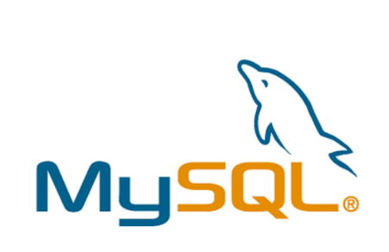

WALMART SALES DATA ANALYTICS USING MYSQL
RESUME PROJECT#1

Slide 2
AGENDA
1.PROBLEM STATEMENT AND PROJECT OVERVIEW
2.WALMART BUSINESS MODEL
3.DATA-SET
4.PROBLEM STATEMENT

Slide 3

ABOUT THE WALMART | PROBLEM STATEMENT | PROJECT OVERVIEW
Walmart is an American multinational retail corporation It operates hypermarkets, discount department stores, and grocery stores | Analyze Walmart sales data to identify top-performing branches and products, understand sales trends, and examine customer behavior to optimize sales strategies. | In this project, I will be Working with a dataset related to sales transaction . The goal is to answer ten+ specific questions using SQL queries
has locations in the United States and in 23 other countries | Sales Trends Analysis: Examine product sales trends and customer behavior to optimize promotional strategies and inventory management. | The dataset was obtained from the Kaggle Walmart Sales Forecasting Competition.

Slide 4

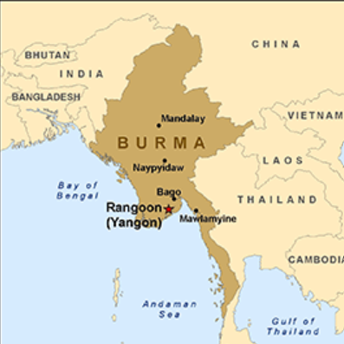
WALMART BUSINESS MODEL
COUNTRY :MAYANMAR
PRODUCT SEGMENT
Mandalay
Electronic accessories
Fashion accessories
Food and beverages
Health and beauty
Home and lifestyle
Sports and travel
Naypyitaw
Yangon

Slide 5
WALMART BUSINESS MODEL
Product Analysis
Conduct analysis on the data to understand the different product lines, the products lines performing best and the product lines that need to be improved.
Sales Analysis
This analysis aims to answer the question of the sales trends of product. The result of this can help use measure the effectiveness of each sales strategy the business applies and what modifications are needed to gain more sales.
Customer Analysis
This analysis aims to uncover the different customers segments, purchase trends and the profitability of each customer segment

Slide 6
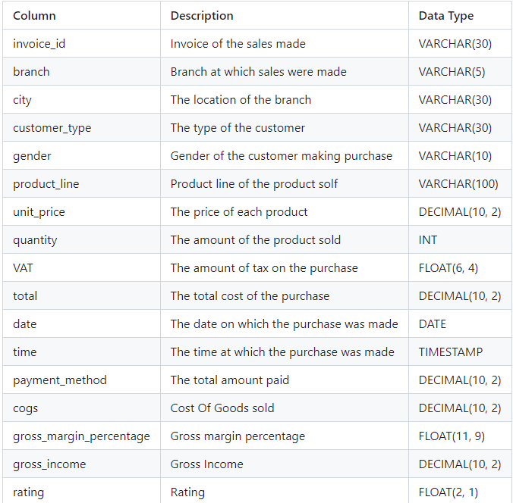
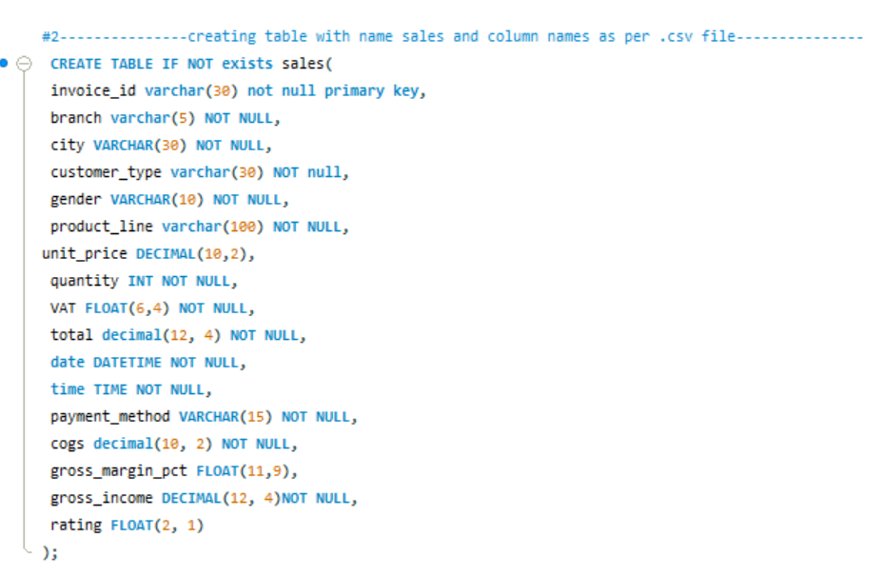
DATA SET
DATABASE
TABLES

Slide 7
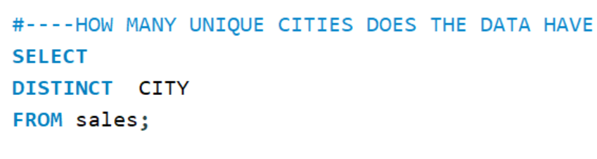
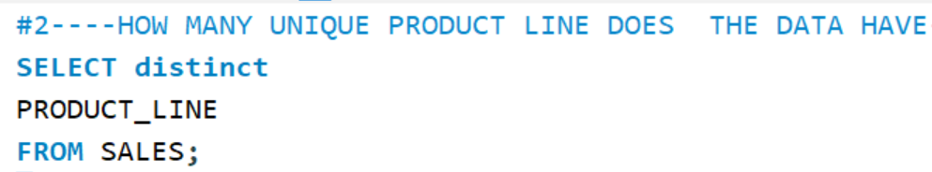
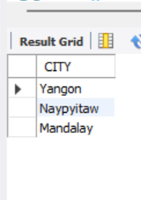
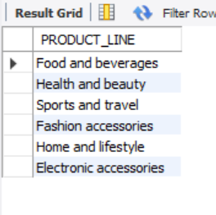
QUERIES
Qn1.HOW MANY UNIQUE CITIES DOES THE DATA HAVE ?
QN2.HOW MANY UNIQUE PRODUCT LINE DOES THE DATA HAVE
OUTPUT:
OUTPUT:

Slide 8
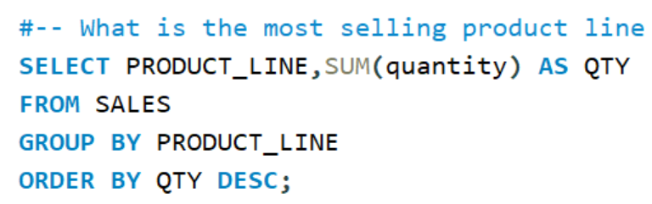
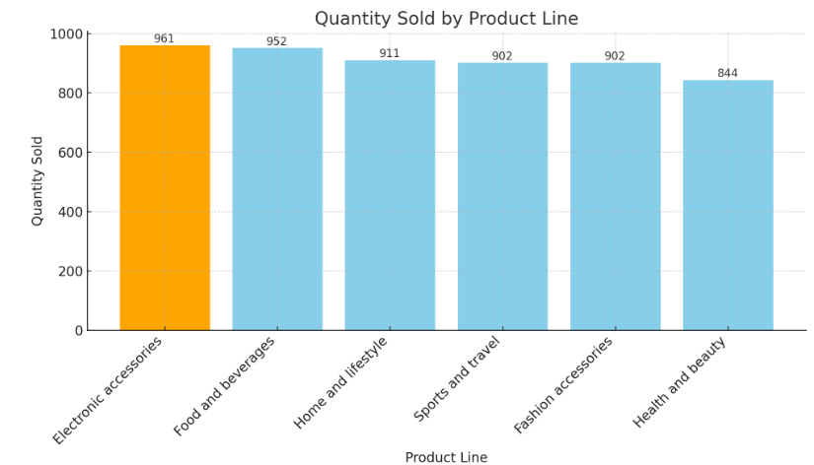
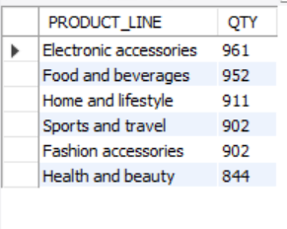
QUERIES
Qn3.Which is the most selling product line?
OUTPUT:

Slide 9
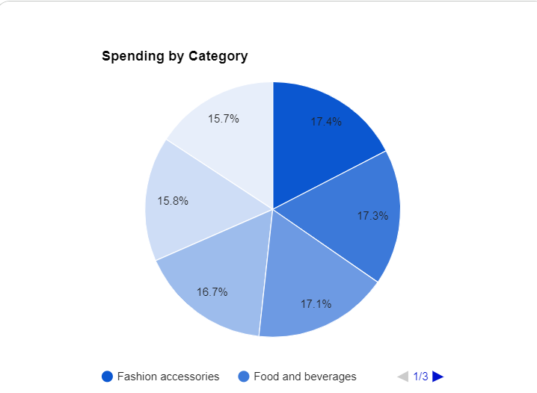
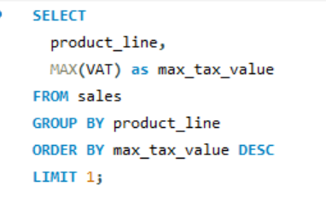


QUERIES
Qn4.What product line had the largest VAT?(VALUE ADDED TAX)

Slide 10
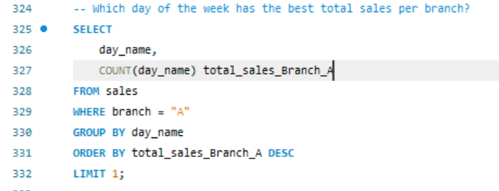

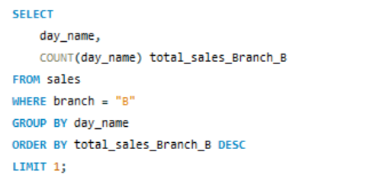


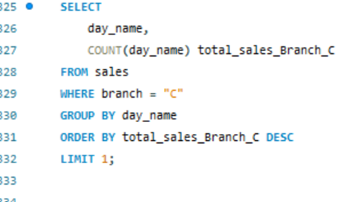
QUERIES
QN.5 Which day of the week has the best total sales per branch

Slide 11
INSIGHTES
QN.5 Which day of the week has the best total sales per branch
Business Improvement Strategies Based on Sales Data
Optimize staffing and resources: Allocate resources based on peak sales days.
Leverage peak sales periods: Promote offers and analyze customer behavior.
Identify underperforming days: Analyze reasons and implement targeted strategies.
Evaluate branch performance: Compare and share best practices.
Consider seasonal factors: Analyze trends and adjust strategies accordingly.

Slide 12
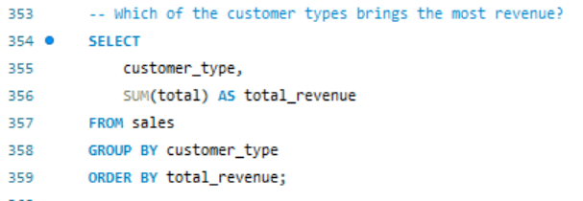
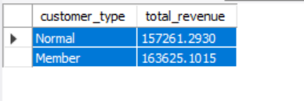
QUERIES
Business Implications
This insight suggests that the company's membership program is effective in driving revenue. Here are some potential business implications:
Prioritize member acquisition and retention: Implement strategies to attract and retain more members.
Enhance member benefits: Offer exclusive perks or discounts to encourage increased spending.
Analyze member behavior: Identify patterns in member purchases to tailor marketing and product offerings.
Evaluate membership program effectiveness: Regularly assess the program's ROI and make necessary adjustments.
Consider tiered membership levels: Offer different levels of benefits to cater to various customer needs and budgets.
By focusing on member acquisition and retention, businesses can capitalize on the higher revenue potential of this customer segment.
QN6. Which of the customer types brings the most revenue?

Slide 13
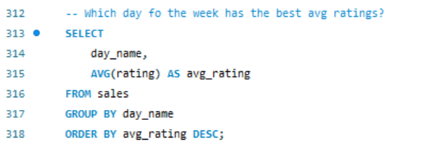
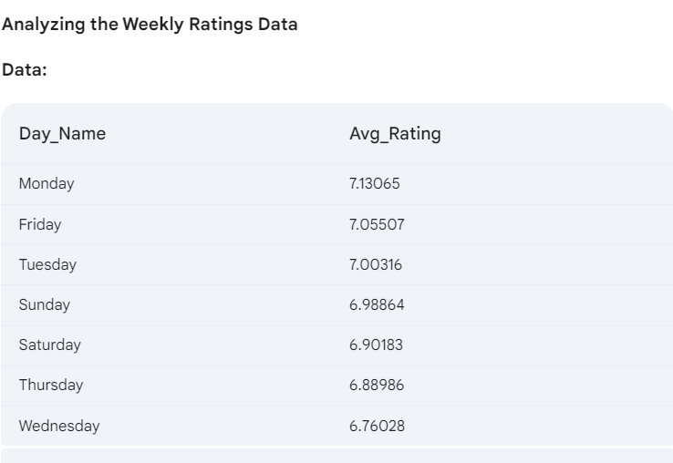
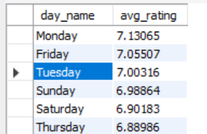
QUERIES
QN7-- Which day for the week has the best avg ratings?

Slide 14
INSIGHTES
Insight:
Monday has the highest average rating, followed closely by Friday and Tuesday.
Business Implications
Here are some potential business implications:
Analyze factors influencing ratings: Identify specific factors that contribute to higher ratings on these days (e.g., staffing levels, promotions, ambiance).
Optimize operations on less popular days: Implement strategies to improve customer experience on days with lower ratings (e.g., offer discounts, create special events).
Leverage peak rating days: Consider scheduling special events or promotions on Mondays, Fridays, and Tuesdays to attract more customers.
Monitor ratings over time: Track changes in ratings to identify trends and adjust strategies accordingly.
By understanding the relationship between day of the week and customer satisfaction, businesses can optimize their operations and marketing efforts to improve overall customer experience.
This insight suggests that customers tend to have a more positive experience on Mondays,

Slide 15
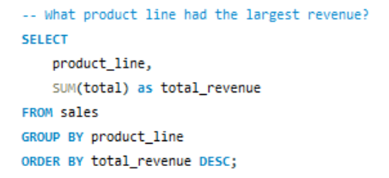
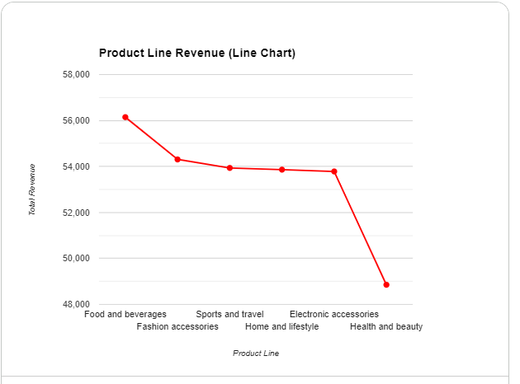
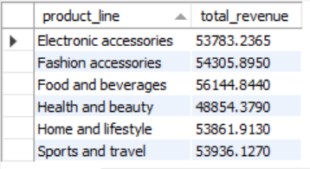
QUERIES
Qn8.What product line had the largest revenue?

Slide 16
INSIGHTES
Qn9.What product line had the largest revenue?
Leverage Top-Performing Product Line: Expand offerings, promote cross-selling, analyze preferences.
Optimize Underperforming Product Lines: Identify reasons, revamp offerings or marketing, consider discontinuation.
Balance Product Portfolio: Diversify product mix and customer base.
Enhance Customer Experience: Gather feedback, provide excellent service, offer personalized recommendations.
Monitor Market Trends: Stay updated and adapt strategies accordingly.

Slide 17
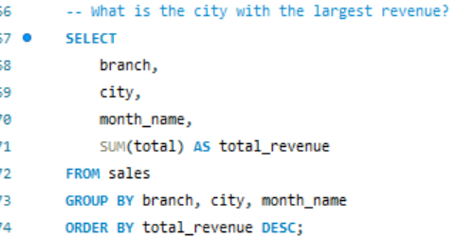
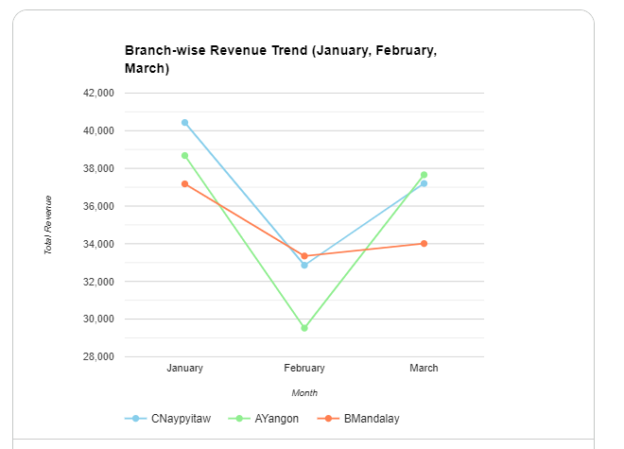
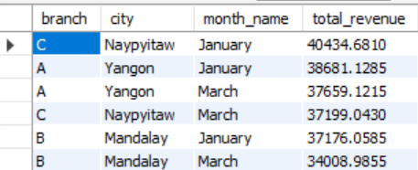
QUERIES
Qn10.What is the city with the largest revenue?

Slide 18
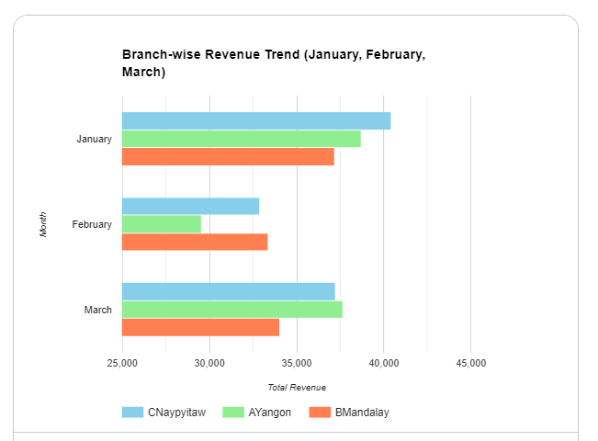
INSIGHTES
QN10- What is the city with the largest revenue?
Product Line Optimization: Leverage top-performing lines, optimize underperforming ones, balance product portfolio.
Branch and City Performance: Identify high-performing areas, optimize underperforming ones, consider regional factors.
Customer Segmentation and Targeting: Analyze customer behavior, tailor marketing and products.
Seasonal and Temporal Analysis: Identify trends, optimize operations and marketing.
Continuous Monitoring and Improvement: Track KPIs, analyze data, implement changes.

Slide 19


